Slide 1


Choices at 16
Nikki Corben
Careers Adviser
Weston Favell Academy
Email: nikki.corben@prospects.co.uk
Tel: 07714 736728
Notes:
Welcome and your introduction to session

Slide 2








What makes you tick…
The people who are most successful in life know themselves, believe in themselves and are determined to succeed.
www.prospects.co.uk
Notes:
The people who are most successful in life know themselves, believe in themselves and are determined to succeed.
Rhianna, Louis Smith (Olympic Gymnast), J K Rowling , Ellie Robinson (Northampton based Paralympian) Sir Alan Sugar, Bill Gates

Slide 3
This presentation covers:
The variety of options that are available to you after Year 11
The wide range of courses available in 6th form and colleges
Opportunities for Apprenticeships
How to apply and where to get more help.
www.prospects.co.uk
Notes:
Go over expected aims and objectives and agree ground rules. Explain that this is a presentation what will require participation from the group. You will go over some information and then there will be a quiz and a form to complete at the end. Important to join in, ask questions and enjoy!

Slide 4

Planning your career path
Think about where you want to go.
Plan how you will get there.
Make choices along the way.
www.prospects.co.uk
Notes:
Go through slide putting the statements into context for the students…

Slide 5
Making good career choices
Nikki Corben is the Careers Adviser in school and Mrs Ford is the School Careers Co-ordinator.
You will be offered an appointment in school to talk through your options and ideas so we can support you onto your next pathway.
www.prospects.co.uk
Notes:
Explain how Connexions helps and works with students…

Slide 6
Options after Year 11
A school
6th form
Further Education
College
A course to help you prepare for work, training and further education
Apprenticeship
or
Traineeship
www.prospects.co.uk
Notes:
Talk through options –
Traineeship - The government has developed a new traineeships programme that will support young people to develop the skills they need to secure and succeed in employment, including apprenticeships.
Employers tell us that they are concerned that young people often lack the right skills and attitudes when they apply for an apprenticeship or other employment. Yet many young people are highly motivated by work, or the prospect of it.
Traineeships will offer these young people the opportunity to undertake a substantial work placement and work skills training, alongside support to improve their English and maths. Depending on the young person’s needs, a range of other support and flexible training may be offered to help them develop their skills and progress quickly onto an apprenticeship or secure other employment
Courses : Foundation Learning is now called ‘Other Study programmes’ and should be referred to as this for those students going on courses offered by training providers.
Stress importance of having backup plan. You can apply to several options at once and decide which to go for later.
This year saw several students not getting grades to do what they wanted and are applying to college last minute which could mean they may not get a place. It’s always best to apply early and turn your place down if you decide to chose another option.
Usually the majority stay in FTE 6th form:

Slide 7
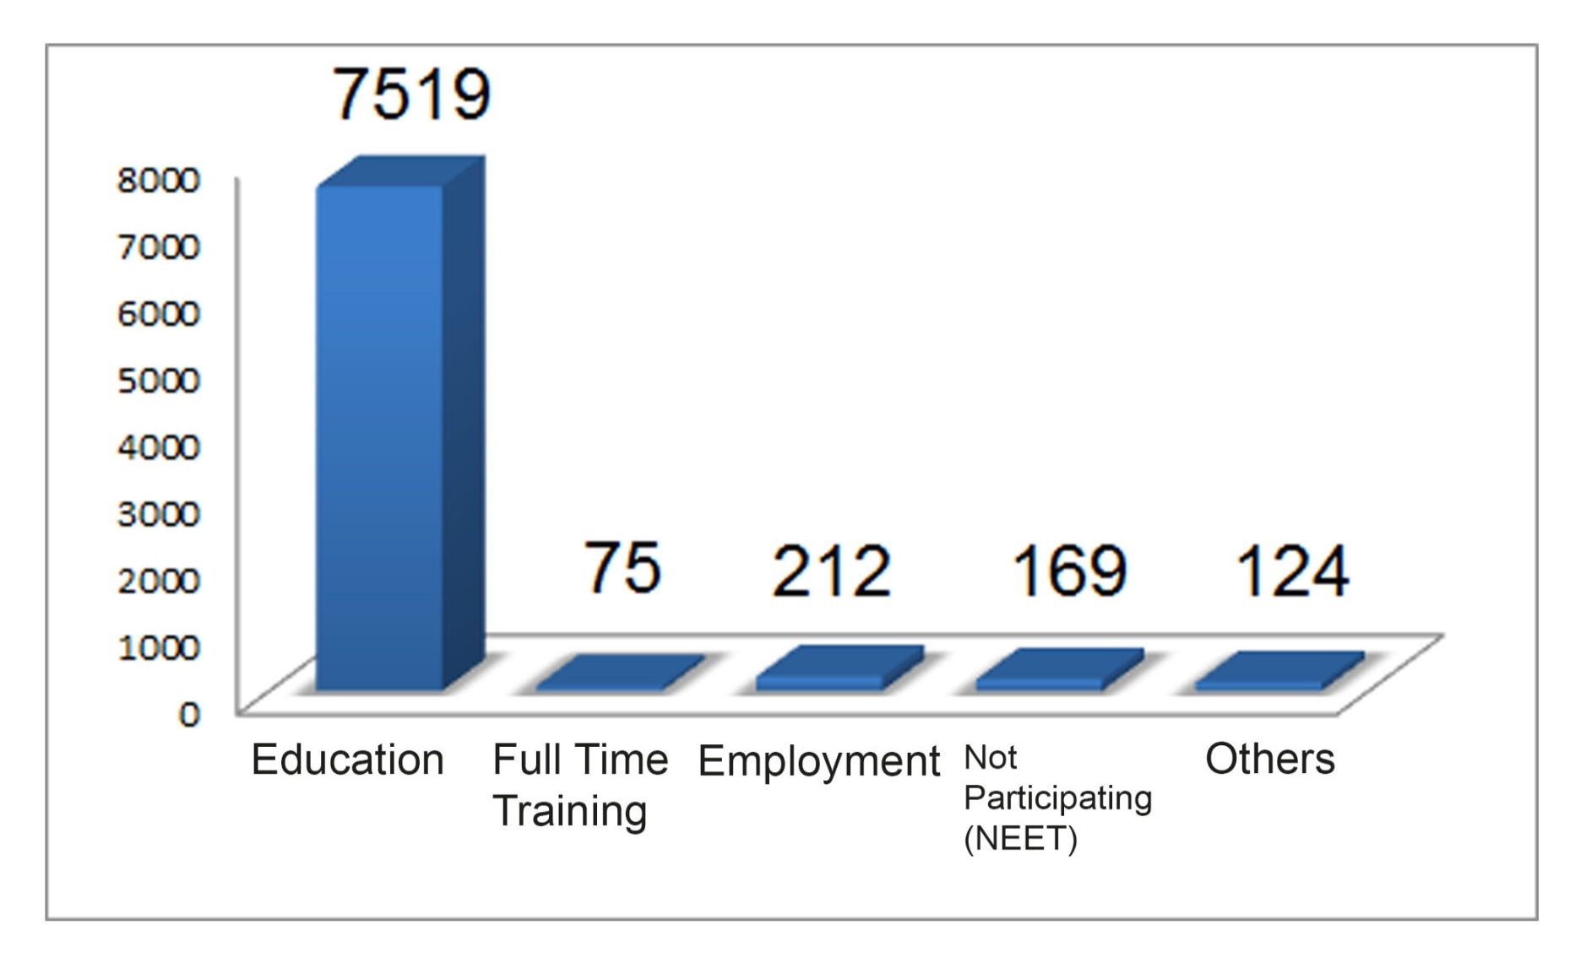
Northamptonshire Year 11 Leavers 2018
www.prospects.co.uk
Notes:
This slide gives you an idea of where students went last year after leaving school. From 7519 students across the county, you’ll see that the majority stayed on in education.
Hopefully you will have heard the term Raising the Participation Age which means you have to stay in in some form of learning until your 18th birthday. Because of this a lot of the above options will not be available for you : –
Ask Question: can you tell me which ones will not count as staying in learning?
Answer : Unemployed, Employment (if without learning), Part time Activities/Volunteering under 20 hours
Get school specific data.

Slide 8




Range of courses in 6th form
A Levels
BTECs
Extra curricular
D of E
Work Experience
www.prospects.co.uk
Notes:
Some/all of these may be available in your school. Inc subjects or qualification types
EPQ = Extended Project Qualification
Work Experience includes volunteering
Alternatively you may go to another 6th form to study subjects that are not available in your school.

Slide 9
Local Colleges
Northampton College
www.northamptoncollege.ac.uk
Moulton College
www.moultoncollege.ac.uk
Other Training
There are smaller training centres and courses
for those that don’t feel ready for college yet.
www.prospects.co.uk
Notes:
Some of the courses offered at the colleges: Colleges bordering – North/East – Leicester, Peterborough Regional College, Huntingdon, New College Stamford. South/west - Rugby Nr Daventry, Banbury – nr Towester/Brackley and Daventry, Milton Keynes..
Hairdressing, Childcare & Early Years, Art, Design & Photography, Beauty Therapy & Business, Plumbing, Aboriculture, Stonemasonry, Floristry, Countryside Management, Wall and Floor Tiling, Environmental Sustainability, Graphic Design, Hairdressing, Photography, Sport – football & rugby
NOTE : MENTION BEDFORD. STAMFORD, PETERBOROUGH IF RELEVANT

Slide 10

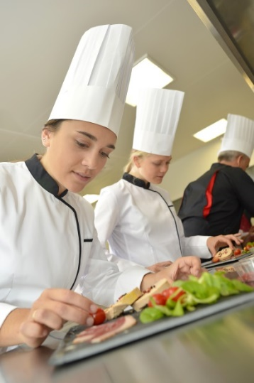

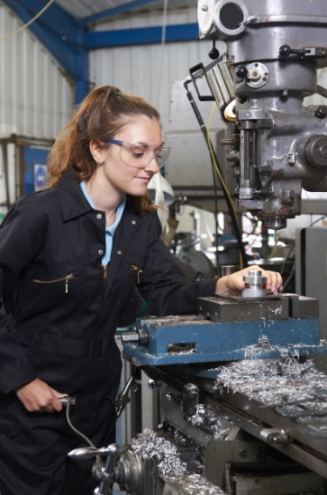


Wide variety of college courses available
(at all levels from no qualifications to University Level study)
www.prospects.co.uk
Notes:
Some of the courses offered at the colleges:
Hairdressing, Childcare & Early Years, Art, Design & Photography, Beauty Therapy & Business, Plumbing, Aboriculture, Stonemasonry, Floristry, Countryside Management, Wall and Floor Tiling, Environmental Sustainability, Graphic Design, Hairdressing, Photography, Sport – football & rugby, athletics

Slide 11

Specialist Colleges in
Northamptonshire
Silverstone UTC
www.prospects.co.uk
Notes:
Silverstone UTC - specialises in High Performance Engineering and Business and Technical Events Management

Slide 12
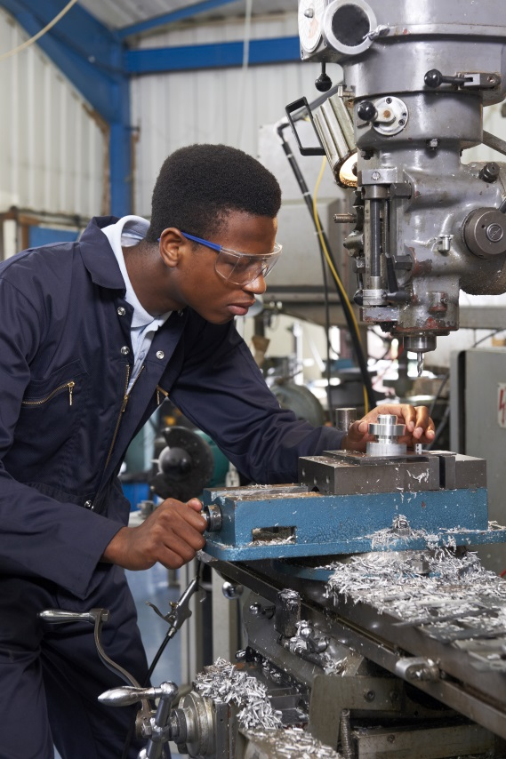



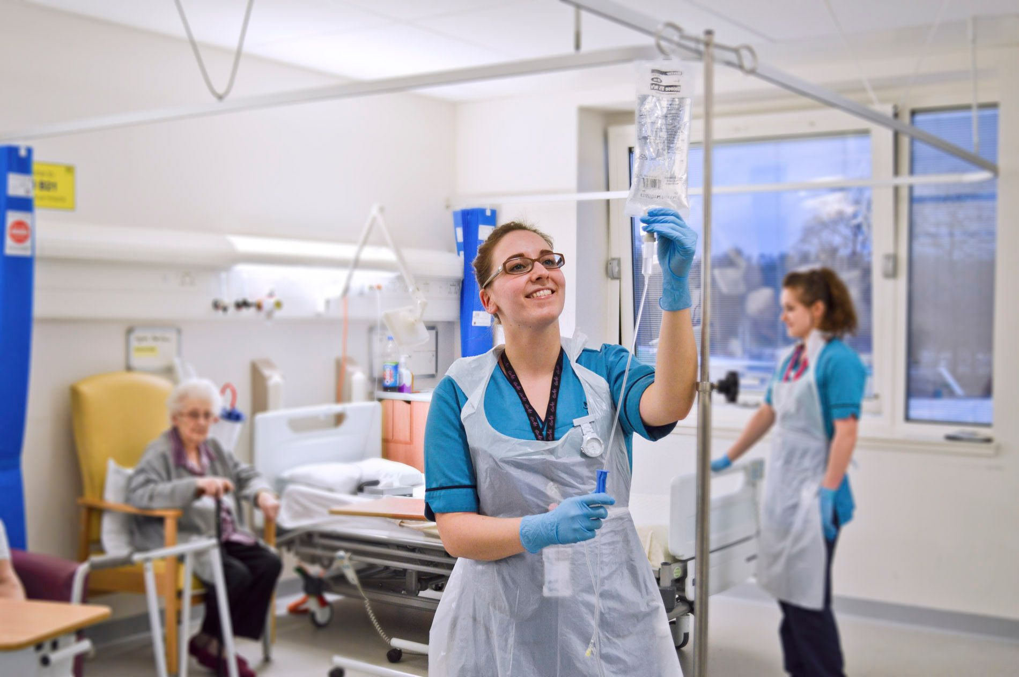
APPRENTICESHIPS
www.prospects.co.uk
Notes:
This is just an example of the types of apprenticeships available – some of these you can do after Year 11 as they count as staying in learning, others are aimed at those who have completed a level 3 apprenticeship and A level leavers. I will show you a website later where you can find out more about what is on offer.
Apprenticeships are now offered at 4 levels : Intermediate Apprenticeship (level 2), Advanced Apprenticeship (level 3) and Higher Apprenticeships (level 4 – equivalent to foundation degree learning) Degree
In some industries, it is possible to progress from level 3 to degree level apprenticeships. eg Business, Retail, Accounting, Heath care (Nursing) and Engineering.
This is now becoming a more realistic option for students as they are earning a wage and getting qualifications whilst gaining valuable experience of work.

Slide 13
Examples of local Intermediate
Apprenticeship job opportunities
Apprentice Engineer £230 per wee
Learning engineering and Polymer technologies
Requirement to attend college for day release
Potential to progress within the company
Salon Apprentice £133.20
Shampooing clients hair
Welcoming customers
Maintaining stock and keeping salon tidy.
Apprentice Recruitment Resourcer £175 per week
Data entry
Dealing with drivers on daily basis
General office duties
www.prospects.co.uk
Notes:
These are just a sample Apprenticeship vacancies we have through Connexions. This will give you a flavour of the types of jobs that you could be applying for next year. School leaver vacancies will become available usually from early next year. Check out the Connexions and Apprenticeship websites which I will show you later to find out more about these opportunities. Other options could be Accountancy, Construction, Human Resource Management, Retail Management, Hospitality Management, Surveying, Business Support, Project Management, Engineering and The Advanced Apprenticeship in Sporting Excellence (AASE).

Slide 14
Examples of local Advanced
Apprenticeship job opportunities
Apprentice Business Administrator £260 per week
Preparation of legal bundles
Dictation
General office duties
Apprentice Design Engineer £200 per week
Designing conveyors and other machinery
Using software including Inventor 3D and Autocad 2D
Occasional site visits
Apprentice Teaching Assistant £136.90 per week
Listen to pupils reading in groups and one to one
To support Class teacher to plan, deliver and evaluate learning activities
Attend meetings, training sessions and school trips.

Slide 15
6th Form and College Open Days
SIXTH FORM
Check Open Evenings with individual schools via their websites
Speak to teachers about studying their level 3 subjects
You can apply to more than one 6th form and/or college
** During Covid many of these will be online **
COLLEGE
Open days have started and are ongoing
throughout the year
It is important to apply to college by Christmas if possible
You can apply to more than one course and more than one college
** During Covid many of these will be online **
www.prospects.co.uk
Notes:
Here are some key points in the year to bear in mind.
6th form – check with your school / other 6th forms via websites. Most tend to hold them later in the year
College – check website for more detail. Worth visiting to get an idea of what college is like and to get as much info about the course before applying.

Slide 16

National Apprenticeship website
www.findapprenticeship.service.gov.uk
If you want an apprenticeship route start
building on your employability skills now
www.prospects.co.uk
Notes:
Use your contacts – speak to family and friends
Approach companies direct and visit company websites
Approach training providers
Consider related areas of work
Think beyond the end of your road!!
Advisers to check if we are putting on any events which is relevant to these students such as Apprenticeship events etc…and mention to them…

Slide 17
Next Steps…
Think about the variety of options that are available to you after Year 11.
Attend your Careers Appointment.
Try to make applications before Christmas (we can support you with this).
Have a main plan and a back up plan (for example, different levels of offers for if your grades aren’t what you expected).
www.prospects.co.uk

Slide 18



